Slide 1


Car Sales
Prediction
DS - 6372 Applied Statistics: Case Study 1
Daniel Chang, Vo Nguyen, Akib Hossian

Slide 2
Introduction
Identify relationships to predict used car prices
This is an observational study
our conclusions are limited to the data included in our analysis.

Slide 3
Objective Summary
Objective 1: Regression with No transform and Log-Linear
Assumptions, Variables Selections, Summary Statistics, Hypothesis Test, Interpretations
Model 1 & 2
Objective 2: Log-log transformations
Model Selection(Lasso, Ridge, KNN)
Model 3 & 4
Parametric and non-parametric regression

Slide 4
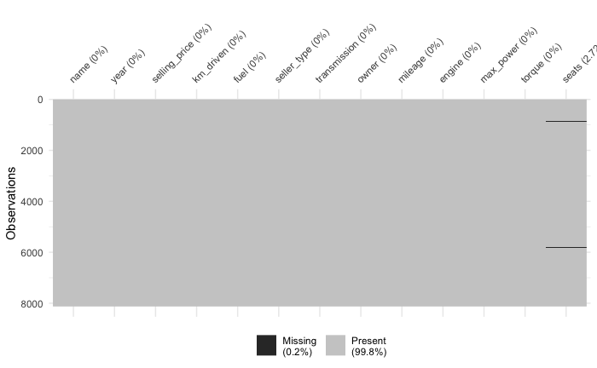
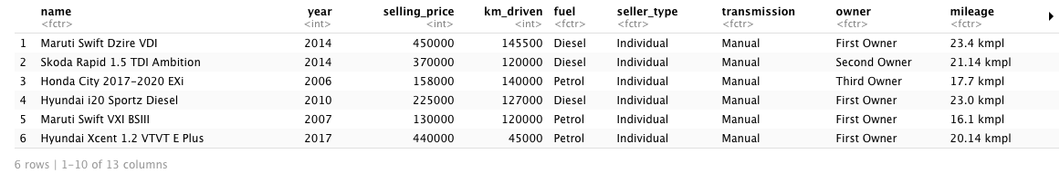
Data Description
Data Collected From: Kaggle.com
8,128 rows and 13 columns with a mixture of numeric and categorical variables
Data collected from 1994-2020
221 Null values, majority in seats column
Omit values

Slide 5
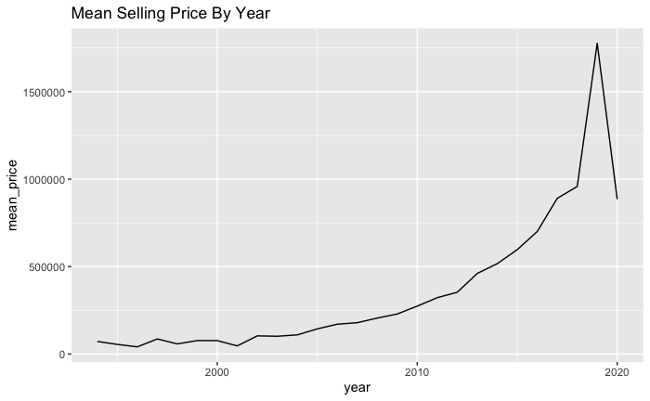
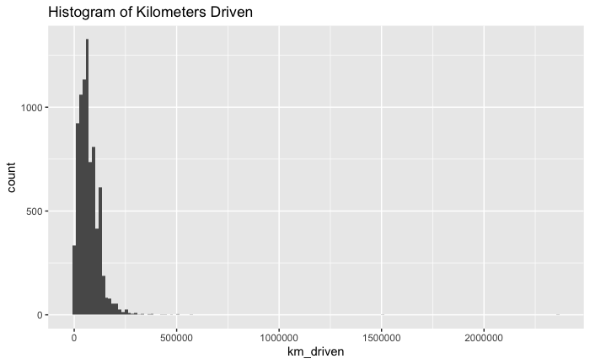
Exploratory Data Analysis

Slide 6
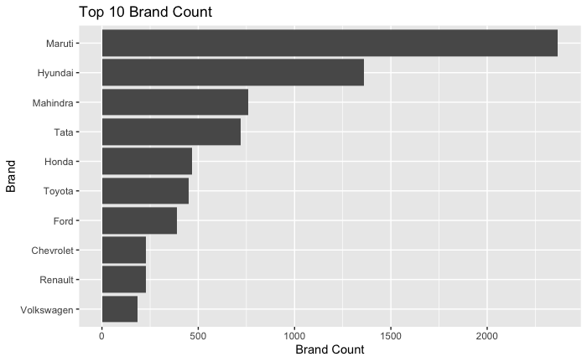
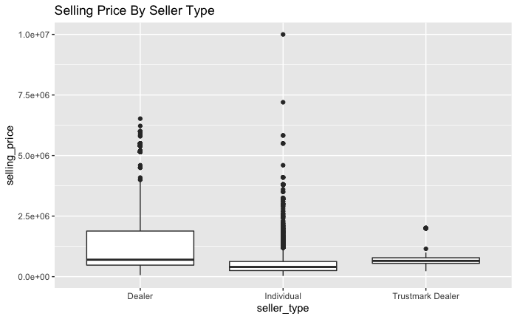
Exploratory Data Analysis

Slide 7
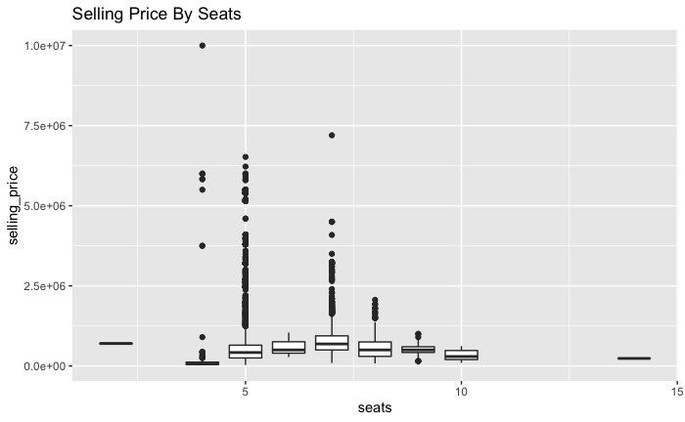
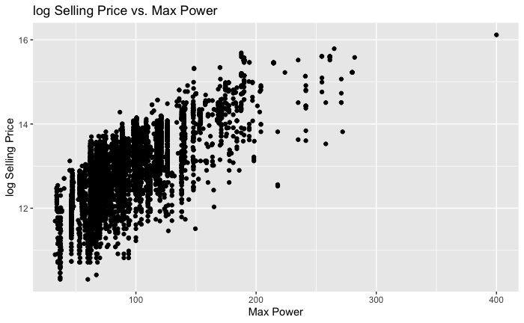
Exploratory Data Analysis

Slide 8
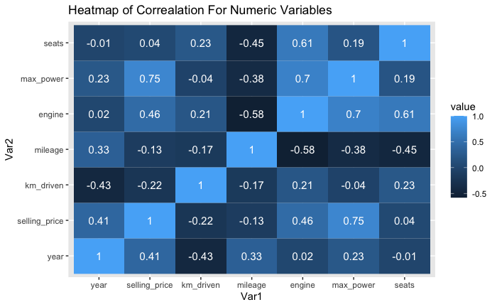
Exploratory Data Analysis

Slide 9
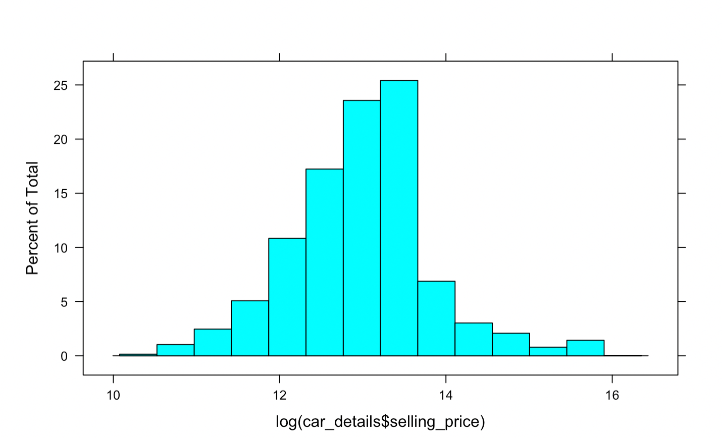
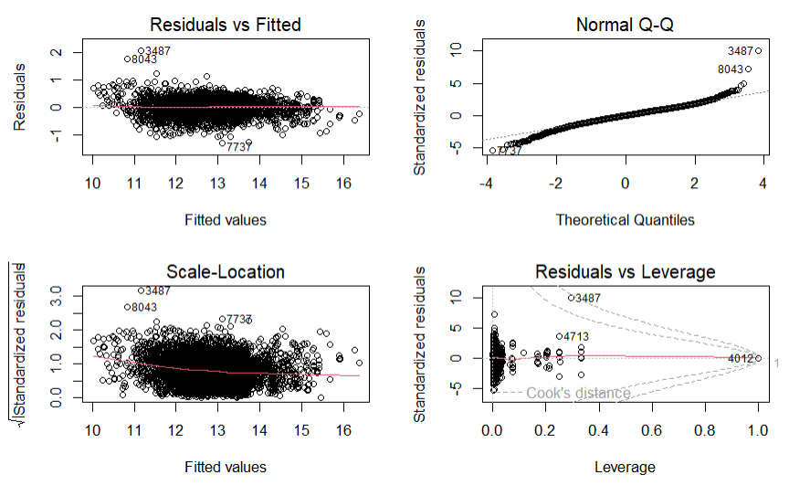
Objective 1
Check the Assumptions
Normally Distributed
Linear Relationship
Independent

Slide 10
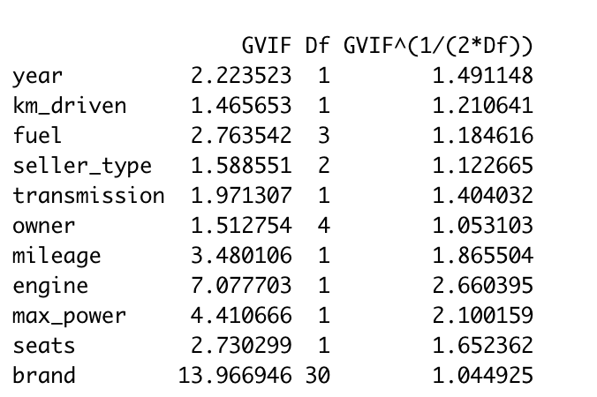
Checking for Multicollinearity
All VIF’s are under 5

Slide 11
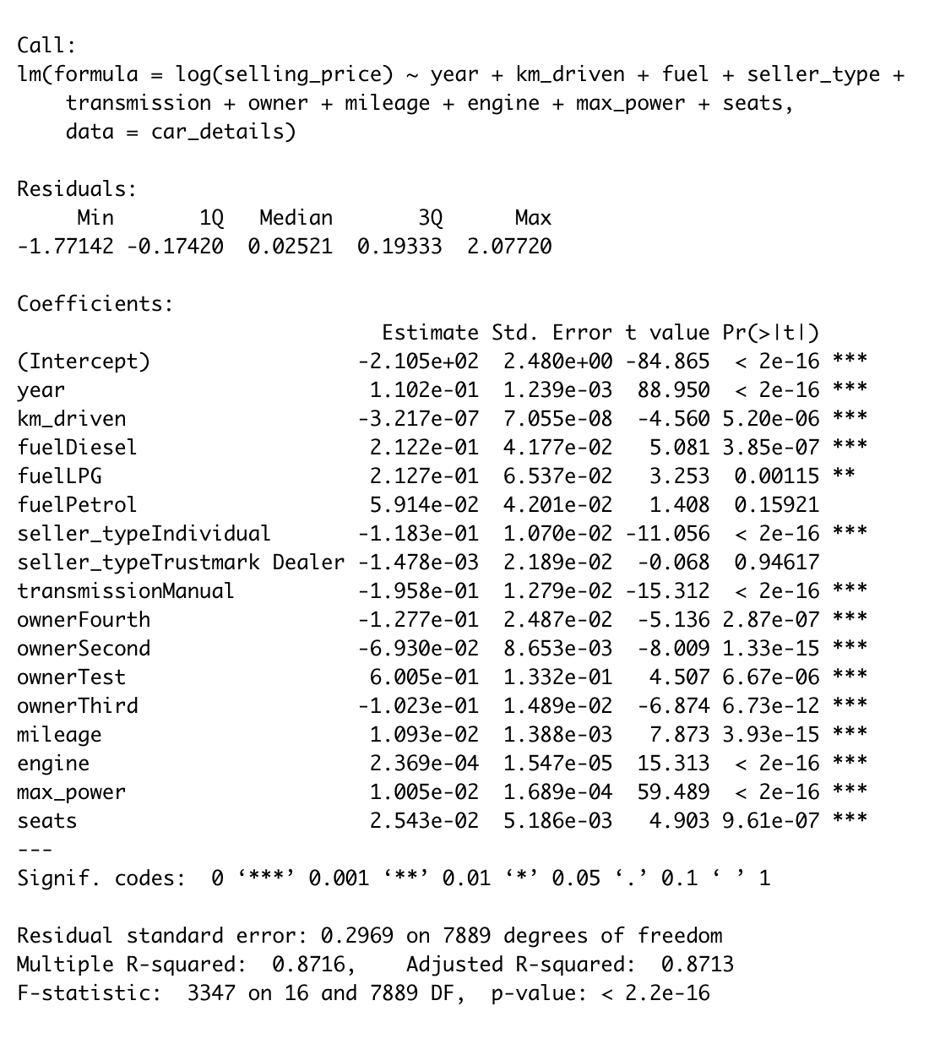
Objective 1
Summary Statistics
How useful is our linear model in predicting the response variable?
Residual standard error : 0.269
Standard deviations of residuals
Smaller residual standard error means predictions are better
Adjusted R^2 : 0.8713
Linear Relation
Larger R2 means the model is better

Slide 12
Objective 1
Variable Selection
Model 1
Selling Price = (4.4e+4)Year - 6.272e-01(KM) - (4.3e+04)Fuel - 5.582e+04(Seller/Ind) - 9.658(Transmission) - -5.87e+04(Owner/2nd) + 3.576e+03(Mileage) + (4.96e+01)Engine + (6.26e+03)MaxPower - (5.189e+03)Seats
Sample Interpretation of Coefficient:
Holding all other variables constant for one increase in selling price there will be a 4.4e+04 increase in year.
Model 2
Log(Selling Price) = (1.154e-01)Year - 3.122e-07(KM) + 1.203e-01(Fuel/Pretrol) - -3.715e-02(Seller/Ind) - 6.717e-02(Transmission) - 8.387e-02 (Owner/2nd) + 8.736e-05(Mileage) + 2.021e-04 (engine) + 8.239e-03(Maxpower) + 3.594e-02(Seats)
Sample Interpretation of Coefficient:
The data suggest each 1 increase in Year is associated with an increase in the median selling price by a factor of e^(1.154e-01) = 1.2. (ie 20% increase)

Slide 13
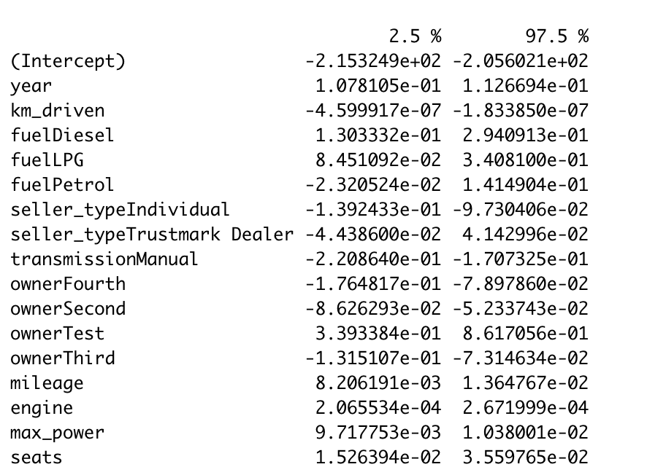
Objective 1
Hypothesis Test
Step 1: H_{o}:β_1=β_*=0
H_{a}:β_1 and β_* <> 0.
Step 2 : T-Stat = 88.95
Step 3: CV = 2.11
Step 4: P-Value = 0.0000001
Step 5: Reject Ho
Step 6 :
There is sufficient evidence to suggest that there is a difference in slope between the predictor variables with a p-value of less than 0.0001 and confidence interval for year being (1.07, 1.12)

Slide 14
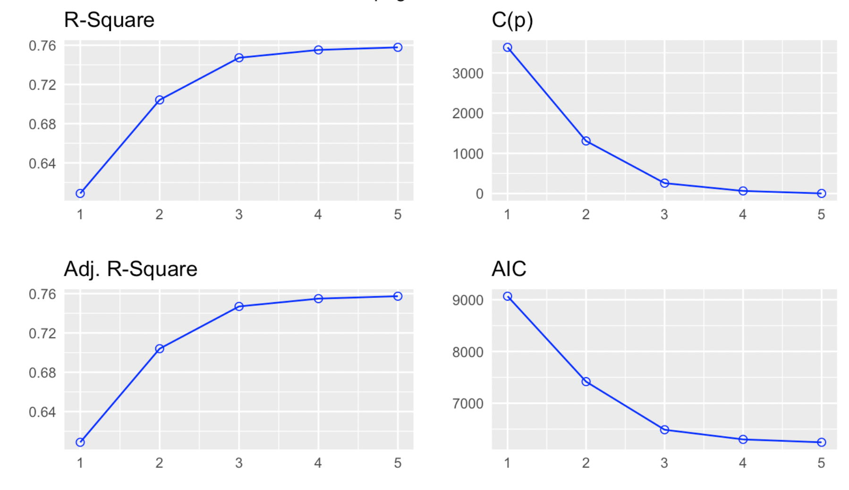
Objective 1
Comparison of Statistics

Slide 15
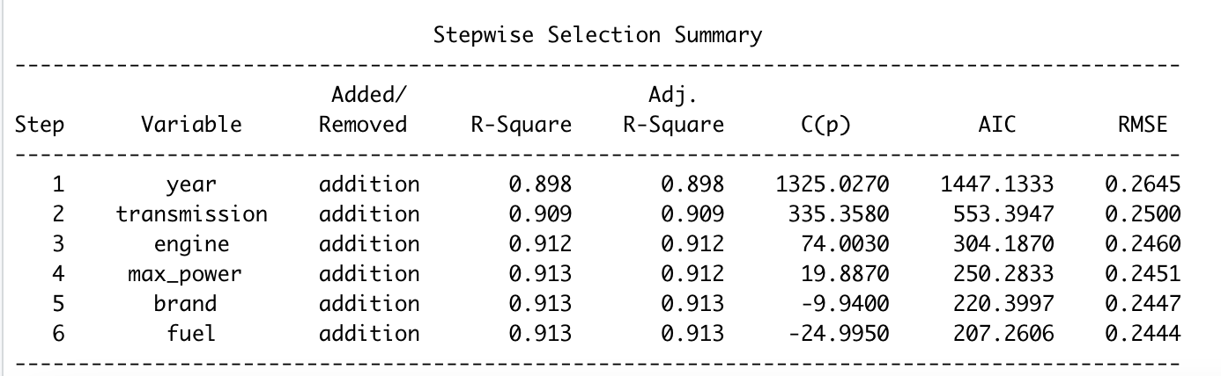
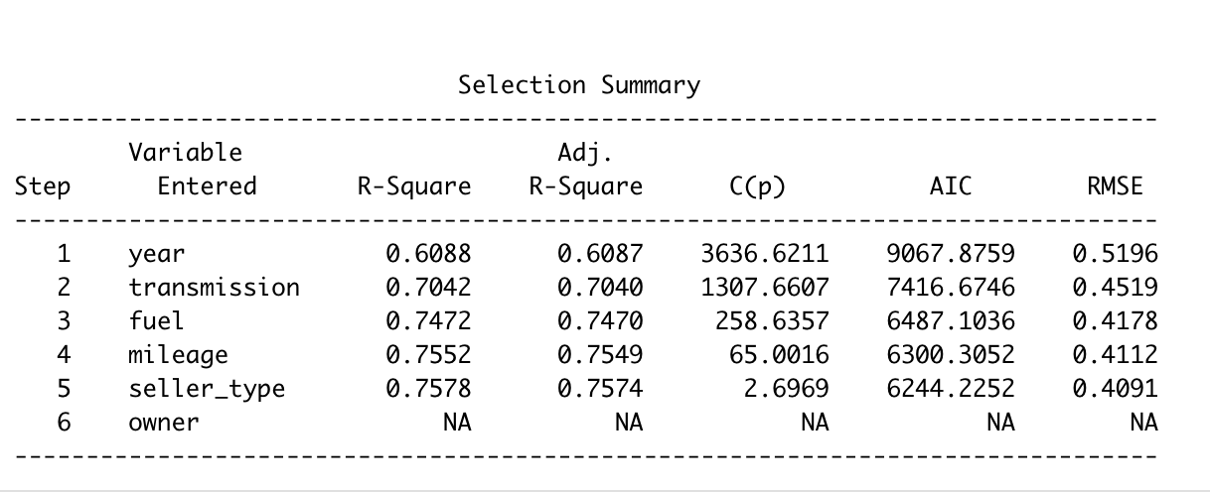
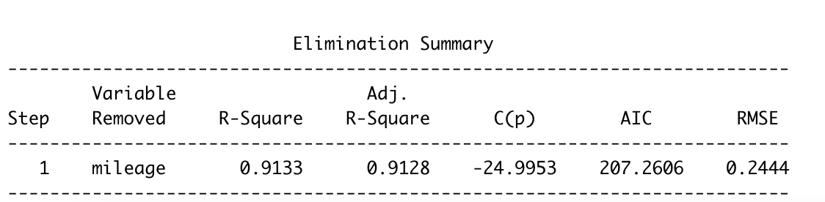
Feature Selection
Stepwise
Backward
Forward

Slide 16
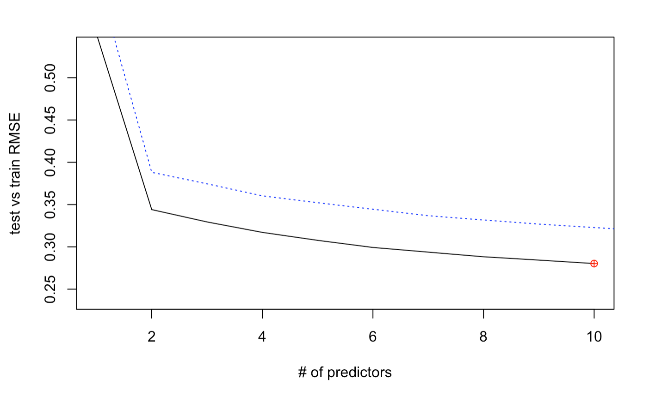
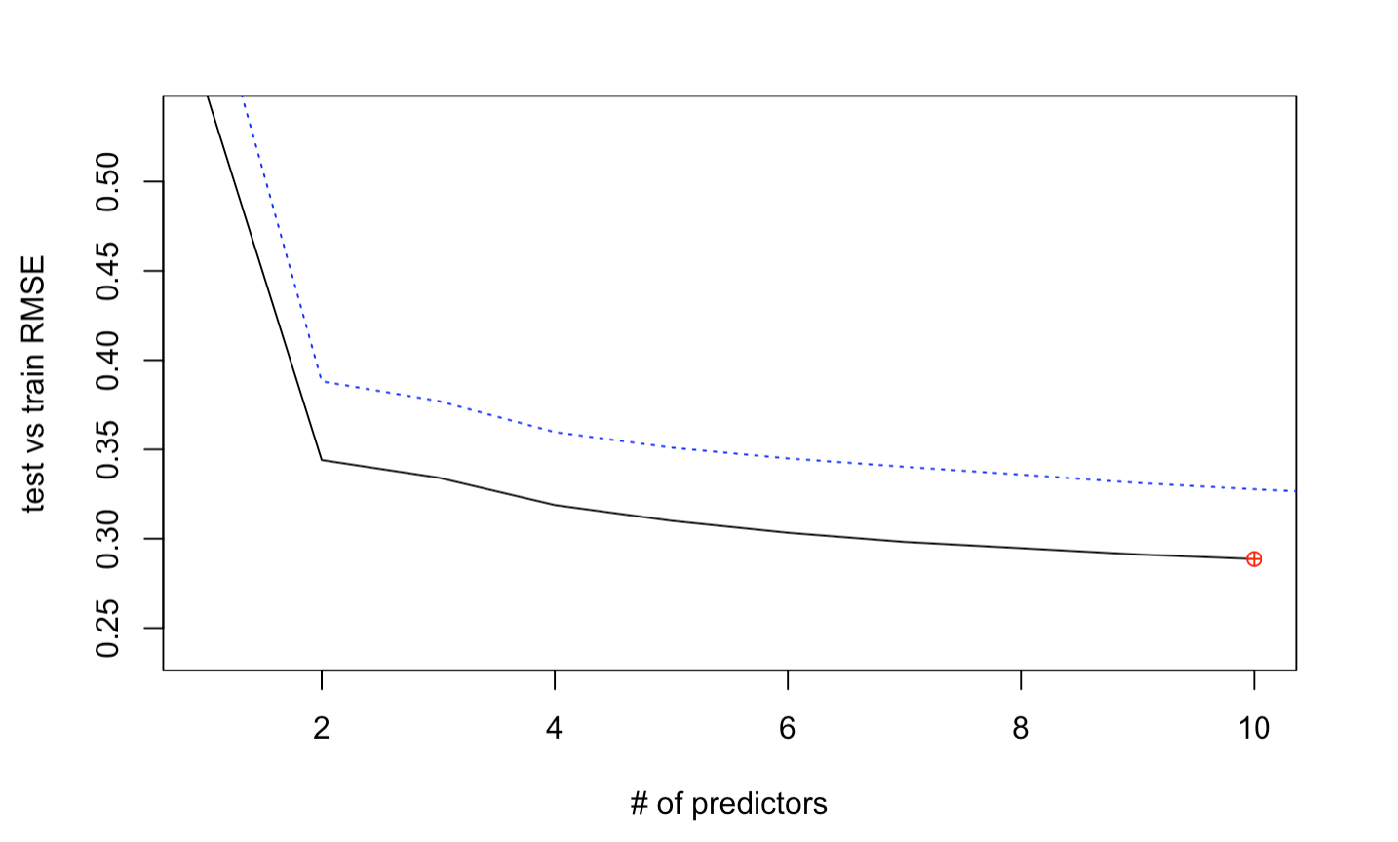
Feature Selection
Forward
Model | ValMSE | Adjusted R^2
Forward | 0.26 | 0.912
Backward | 0.28 | 0.912
Backward

Slide 17
Objective 2
Model Selections
Model 3: Log-Log Model
Log(Selling Price) ~ Predictors + Log(Predictors)
Model 4: Log-Log Model + Interactions
Log(Selling Price) ~ Predictors + Log(Predictors) + Interaction Terms
Notes:
In objective 2, we will performing additional complexities in our models in the hopes of improving better predictability and decreasing errors or variance. Previously in Model 2, we had a log-linear model, but now we are going to try a Log-Log transformation for model 3. Additionally, on our Model selection 4, we will adding interaction terms.

Slide 18
Objective 2
Model 3 Log-Log Model
Log Transformations on Response and Predictors
Log(Selling Price) ~ Predictors + Log(Predictors)
Seller Type
Owner
Fuel
Transmission
Brand
Mileage (Contains Zeroes)
Log(Max Power)
Log(Seats)
Log(Km_driven)
Log(Engine)
Log(Selling Price) ~ +
Notes:
Model 3 focuses on the Log-Log model. We will first log any predictors that are numerical and leave the categorical variables alone. Note that Mileage is technically a numerical response, but contains the value of 0 in the information, which would mean a new car. Log(0) is undefined, so we went ahead and kept Mileage without logging.

Slide 19
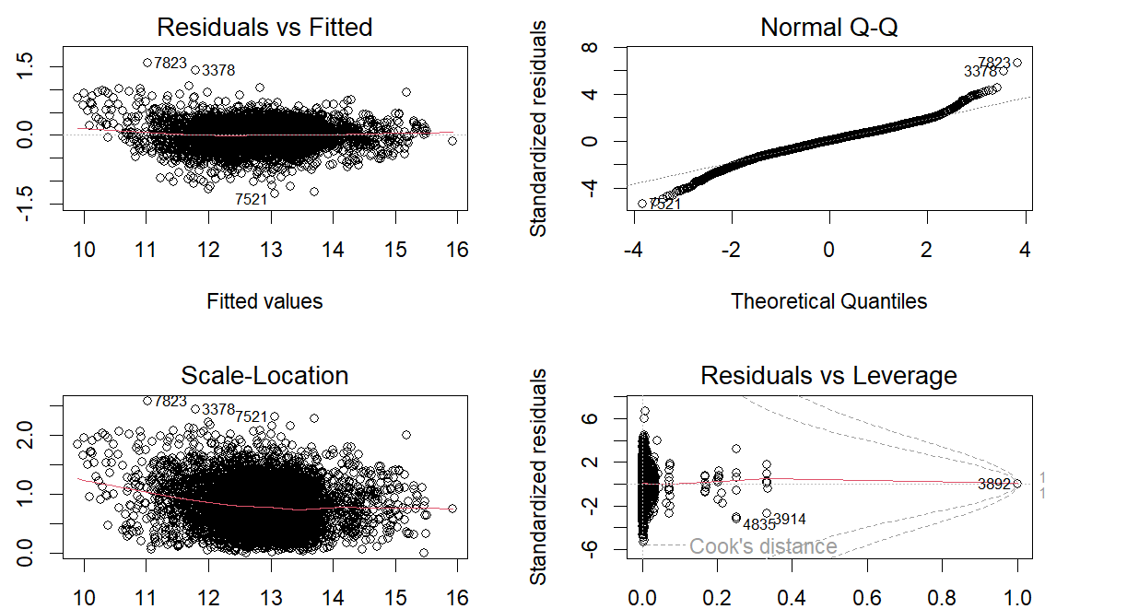
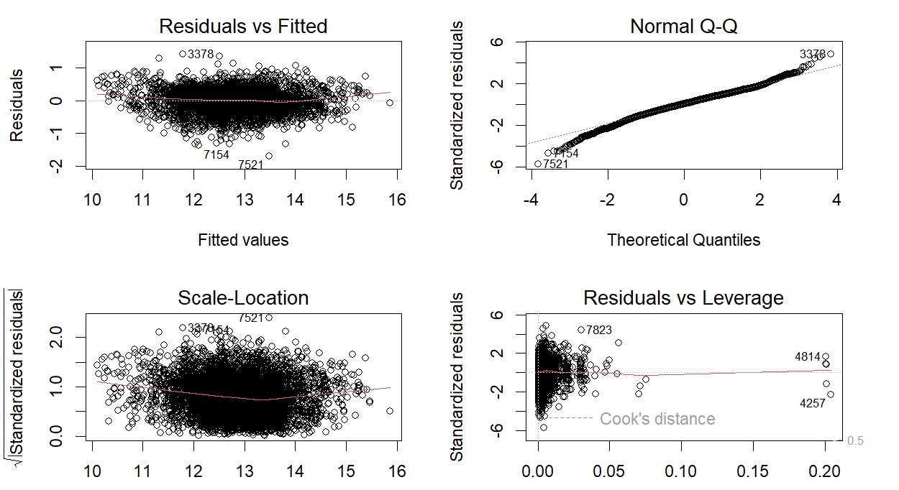

Objective 2
EDA Normality & Constant Variance
Log(Selling Price) ~ Predictors + Log(Predictors)
Log(Selling Price) ~ Predictors + Log(Predictors) + Interaction Terms
Notes:
Quick EDA for the Assumption check, we first look at the constant variance, everything looks good. QQ plot seems pretty normal, and the Scale-Location looks almost normal. Now comparing that to the one with the interaction terms we see standardized residuals are better. We are confident that adding interactions will help our model.

Slide 20
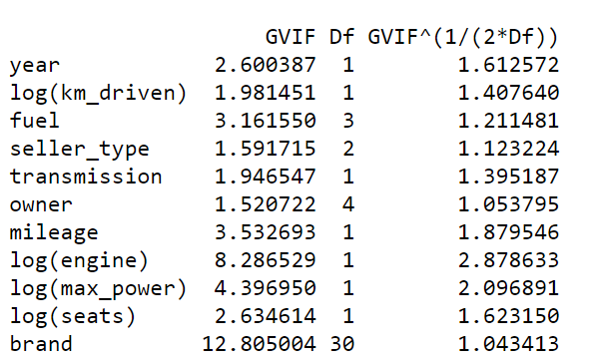
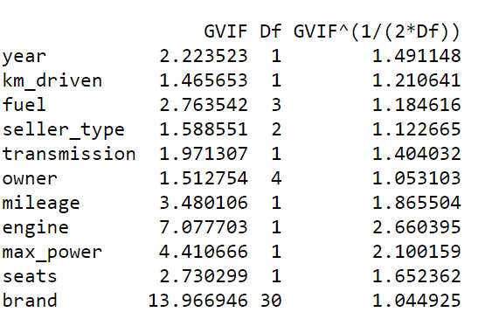

Objective 2
EDA VIF: Multicollinearity
Model 4: Log-Linear Model
VIF < 5
Model 3: Log-Log Model
VIF < 5
Log(Selling Price) ~ Predictors + Log(Predictors)
Log(Selling Price) ~ Predictors
Notes:
Now we want to check for any multicollinearity among the variables. We are using the criteria for < 5 for having low multicollinearity. We are going to use this right column as it is a better VIG checker among the variables. Everything looks good and below 5. Now let’s check Model 4, we are still using the same criteria of less than 5, and everything looks good. We might have high for engine, but it makes sense because engine kind of correlates to mileage, power, and transmission

Slide 21
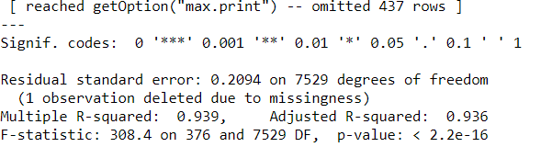
Objective 2
Model Selection Statistical Significance
Model 4: Log-Log Model + Interactions: P-value < .05 (More Complexity)
Step 1) Run R Code using a full interaction in R
Step 2) Picking out Statistically Significant Values
Log(Selling Price) ~ Predictors + Log(Predictors) + Interaction Terms
Seller Type
Owner
Log(Max Power)
Log(Seats)
Year: Log(km_Driven)
Year: Seller_Type
Year: Owner
Year: Log(Max Power)
Log(Max Power): Log(Km Driven)
Log(Km Driven): Log(Seats)
Log(Km Driven): Log(Engine)
Fuel: Seller Type
Log(Selling Price) ~ + +
Notes:
In Model 4, we focused on using the previous Log-Log model, but adding additional interactions terms. Looking at the variables, some of the variables make sense in interacting with each other even after the

Slide 22
Objective 2
Model Selections CV Approach
GLM-NET Regression
(Lasso/Ridge)
Multiple Linear
Regression
KNN
Regression
(Non-Parametric)
Log(Selling Price) ~ Predictors + Log(Predictors)
Log(Selling Price) ~ Predictors + Log(Predictors) + Interaction Terms
Notes:
In our objective 2, we are going to do an alternative method approach of using the k-fold cross validation, which will help address the issue of varying validation MSE using different techniques of training the data.

Slide 23
Objective 2
Summary Approach
Model Selection & Assumptions Check
We will be focusing on using Model 3 (Log-Log) & Model 4 (Log-Log with Interactions)
Our assumptions of Normality and Constant Variance is good enough to continue
We checked the VIF for any multicollinearity, and everything is less than 5, which is good.
Lasso Regression & Multiple Linear Regression
We will be performing a GLMNET Regression using repeated 10-fold Cross Validation with both our models
We will examine the best penalty term in our mixing percentages for lowest Root Square Mean Error
We will have a model of the GLMNET Regression with the final coefficients
We will also perform a regular Linear Regression using repeated 10-fold Cross Validation for lowest RSME and R-squared
KNN Regression
We will be performing a K-Nearest Neighbors using 10 fold CV with our both our models
We will examine the k (#Neighrbors) for lowest Root Square Mean Error
Measure of Fit for Comparisons
We will be comparing the Lasso Regression, Linear Regression, KNN Regression results 10-fold Cross Validation for for the best RSME and R-squared
Notes:
Performing LASSO using 10 fold CV

Slide 24
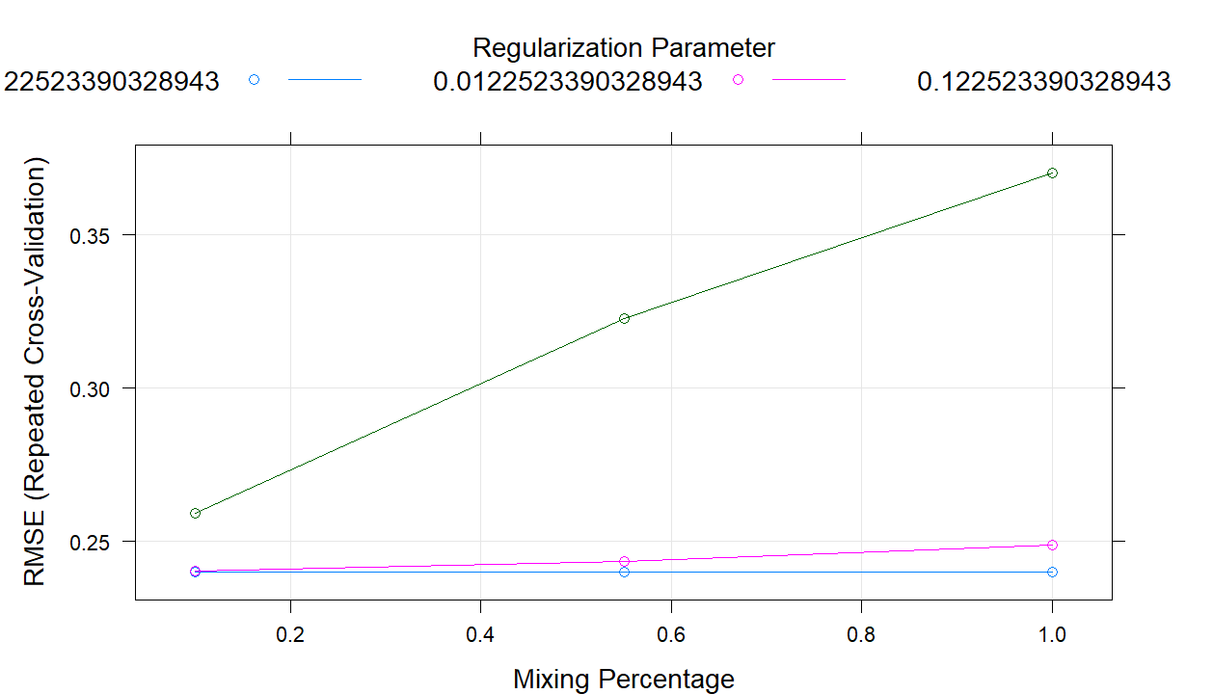
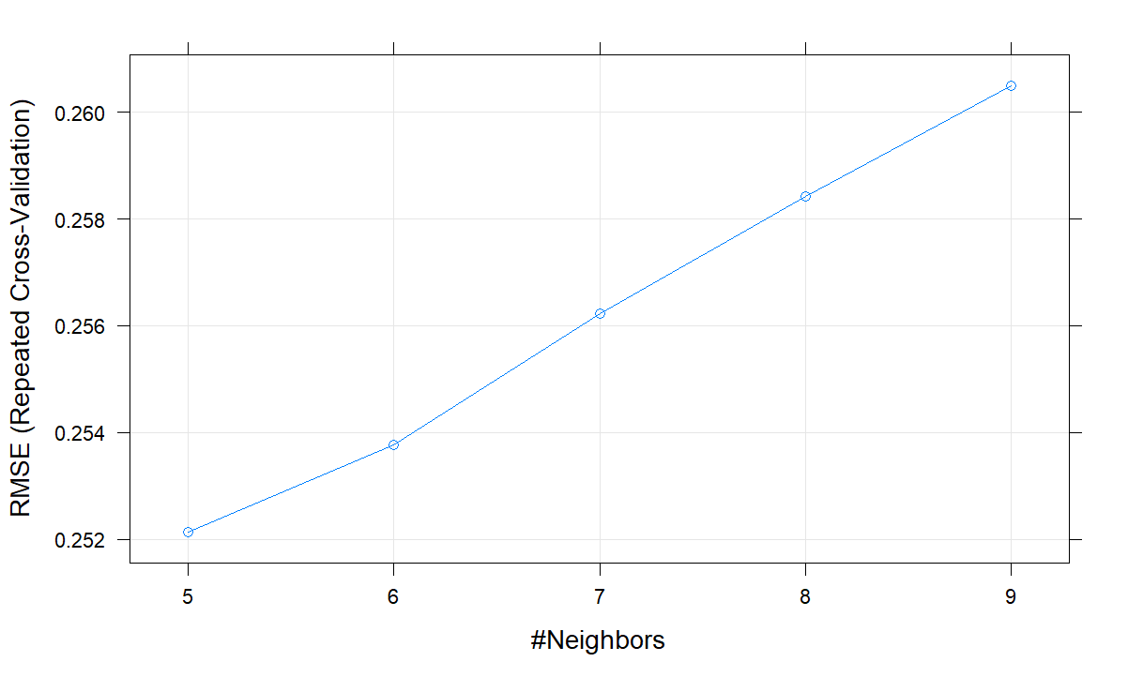
Objective 2: Model 3: Log-Log
Regression Model | Parameters | Metrics
GLMNET (Mixed) | Alpha = 0.55 Lambda = 0.001225234 | RSME = 0.2400668 R-squared = 0.9158387
LASSO / RIDGE | Alpha = 1 Lambda = 0 Alpha = 0 Lambda = 0 | RSME = 0.2398871 (LASSO) R-squared = 0.9158575 (LASSO) RSME = 0.2431986 (RIDGE) R-squared = 0.9146698 (RIDGE)
LINEAR |  | RMSE = 0.2397446 Adj R-squared = 0.9159798
KNN | K = 5 | RMSE = 0.2514574 R-squared = 0.9075544
Notes:
Upon examing the results of the LASSO, we see that the chosen optimal penalty term does not squeeze of the coefficients.
We are comparing the RSME for KNN(k = ?) model is _______ and the RMSE of the Lasso Regression model is . Just comparing the two numbers of KNN wins out.

Slide 25
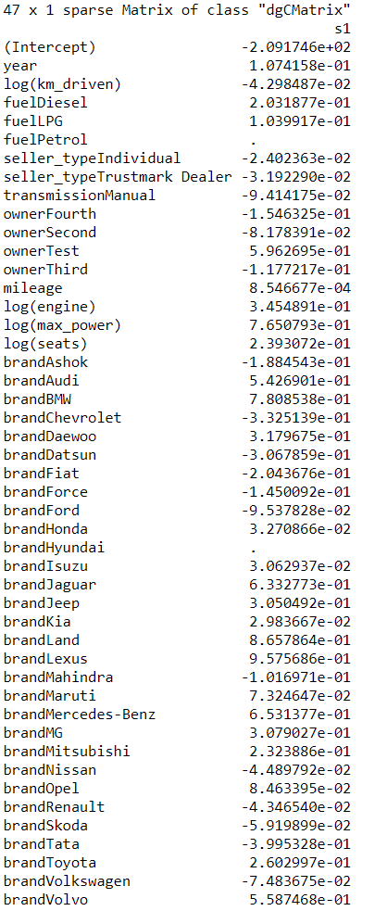
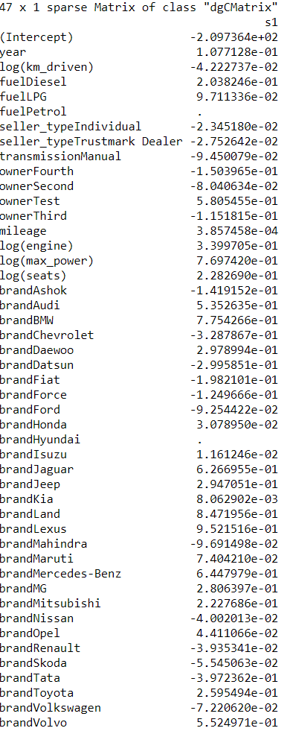
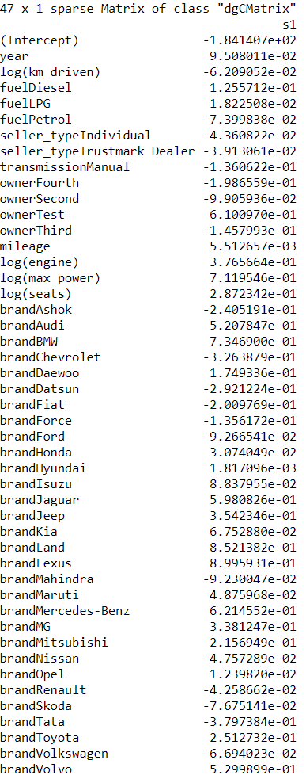
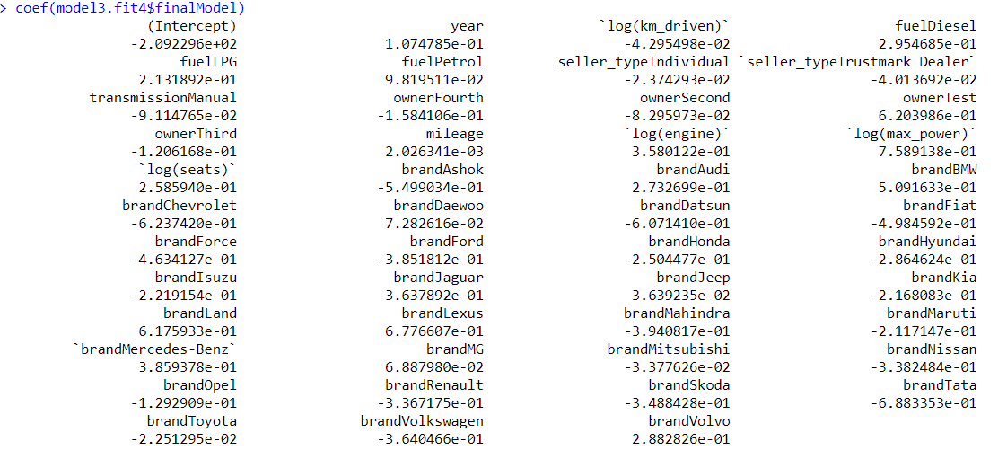
Objective 2: Model 3: Log-Log Coefficients
GLMNET (Mixed) Lambda = 0.001225234 | LASSO / RIDGE Lambda = 0 | LINEAR
Sample Interpretation for Year:
For a double of year, the median of the selling price will change by 7.73%
(100*(2^.1074785-1))
holding all other variables fixed.
Notes:
Comparing the coefficients we see that they more or less are almost identical to each other in the intercepts and values.

Slide 26
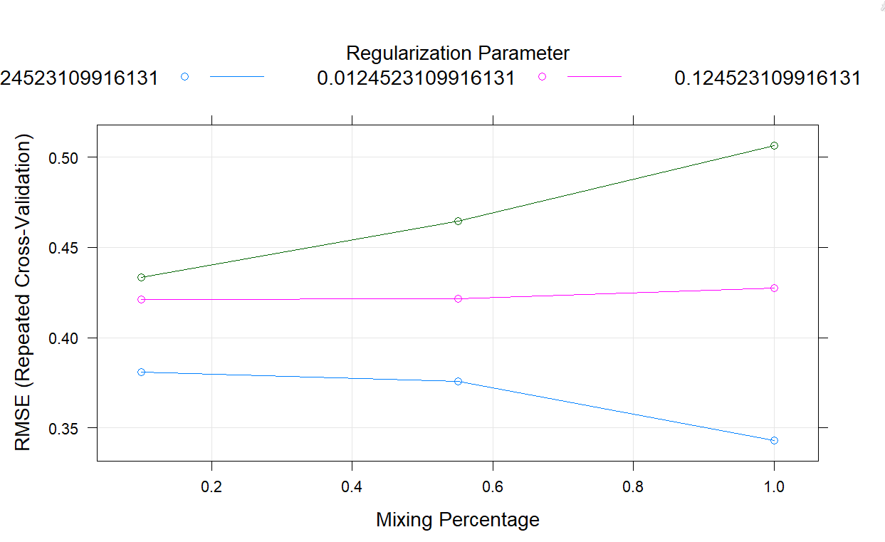
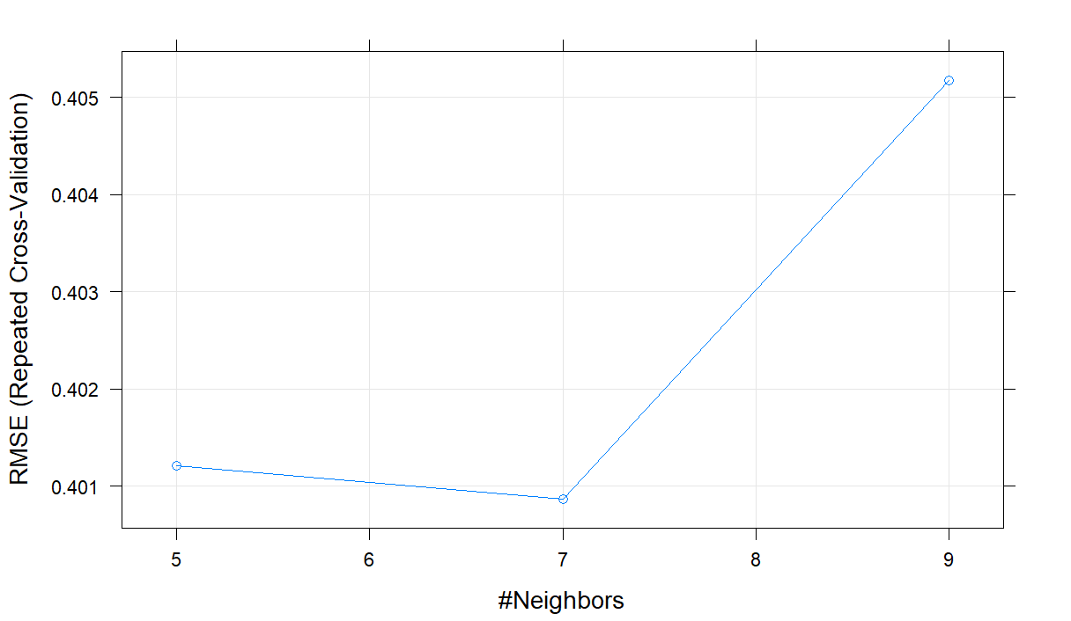
Objective 2: Model 4: Log-Log with Interactions
Regression Model | Parameters | Metrics
GLMNET (LASSO) | Alpha = 1 Lambda = 0.001225234 | RSME = 0.3430600 R-squared = 0.8291422
LASSO / RIDGE | Alpha = 1 Lambda = 0 Alpha = 0 Lambda = 0 | RSME = 0.30112 (LASSO) R-squared = 0.8674285 (LASSO) RSME = 0.4269854 (RIDGE) R-squared = 0.7346539 (RIDGE)
LINEAR |  | RMSE = 0.2968859 Adj R-squared = 0.8708812
KNN | K = 7 | RMSE = 0.4008709 R-squared = 0.7654913
Notes:
Now on to Model 4,

Slide 27

Objective 2 Comparing Both Models
Model 3: Log-Log | RMSE | R-squared
GLM-NET | 0.2400668 | 0.9158387
LASSO / RIDGE | 0.2398871 (LASSO) | 0.9158575 (LASSO)
LINEAR | 0.2397446 | 0.9159798
KNN | 0.2514574 | 0.9075544
Model 4: Log-Log with Interactions | RMSE | R-squared
GLM-NET | 0.3430600 | 0.8291422
LASSO / RIDGE | 0.30112 (LASSO) | 0.8674285 (LASSO)
LINEAR | 0.2968859 | 0.8708812
KNN | 0.4008709 | 0.7654913
Notes:
Comparing the results we see that adding a interaction terms does increase the RMSE and decrease the R-squared. Out of both models, it seems like it would be safe just to keep a Log-Log interaction. The winner of todays result is a tie between Lasso/Ridge. But remember since Lambda is equal to 0 then we know that it is not adding any penalty term, so we basicalaly have a linear regression. Thus, traditional multiple linear regression with log-log transformation is best.

Slide 28
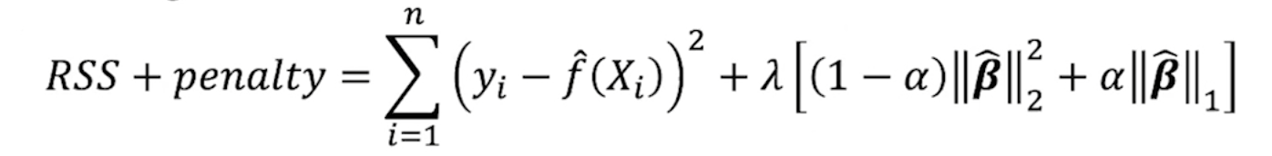
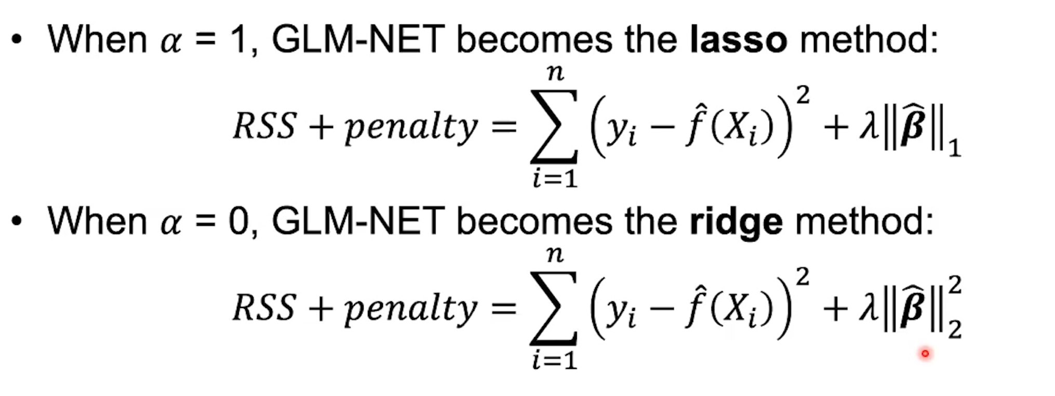
Lasso and Ridge Deep-Dive Analysis
Regression Model | Parameters | RSME / Adj R-squared
LASSO / RIDGE (Model 3) | Alpha = 1 Lambda = 0 Alpha = 0 Lambda = 0 | RSME = 0.2398871 (LASSO) R-squared = 0.9158575 (LASSO) RSME = 0.2431986 (RIDGE) R-squared = 0.9146698 (RIDGE)
LASSO / RIDGE (Model 4) | Alpha = 1 Lambda = 0 Alpha = 0 Lambda = 0 | RSME = 0.30112 (LASSO) R-squared = 0.8674285 (LASSO) RSME = 0.4269854 (RIDGE) R-squared = 0.7346539 (RIDGE)

Slide 29
Objective 2
Conclusion
Final Remarks
Lasso Regression may not have a lower RMSE, but provides complexity to our model with a better balance of bias variance trade-off.
(Model 4) Ridge Regression (Alpha = 0) forced lambda = 0, which meant that our penalty terms was not needed, and thus it is just a MLR.
KNN Regression Performed the worse out of all of our models today.
Unable to Interpret Model 4 coefficients because of interactions.
Winner:
Traditional MLR for Model 3 (Log-Log) has the lowest RMSE of 0.23 and Adjusted R-squared of 0.92

Slide 30
Conclusion
Final Remarks
Objective 1:
Model 1: No Transformation
Model 2: Log-Linear Transformation
Stepwise Selection Model wins
RMSE: 0.2444
AIC:207.2606
R-Squared: 0.913
Winner:
Objective 2
Traditional MLR for Model 3 (Log-Log) has the lowest RMSE of 0.23 and Adjusted R-squared of 0.92. Our best model
KNN Regression Performed the worse out of all of our models

Slide 31
Conclusion
Final Remarks
Scope of Inference: Observational Study
Insights from model:
Variables that can help accurately determine selling price
Given more time and resources
testing on more data collected from different car dealerships/websites
Find additional variables that affect car prices such as car edition, state, etc.

Slide 32
THANKS!
Any Questions or Concerns?
Danny Chang
Changd@mail.smu.edu
Akib Hossian
Akibh@mail.smu.edu
Vo Nguyen
VoChanNguyen@gmail.com

